Slide 2
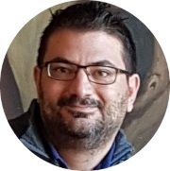
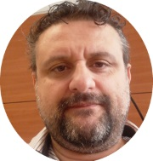
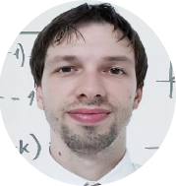
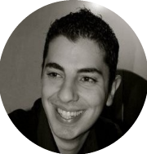
Maui
Scifoni Ivano
Fabio Mannis
Francesco Del Re
Matteo Riccardi
Valerio Benedetti

Slide 3
Maui
Agenda

Slide 4
Maui

Slide 5
Questions
&
Answers

Slide 6
Maui

Slide 7
Thank You!
Our Socials

